Slide 1
Data Structures

Slide 2
Data Structure
Overview of module
Introduction to Data Structures
Makefiles
Time Complexity
Linked List
Stack
Queue
Searching Techniques
Sorting Techniques
Tree
Hashing

Slide 3
Data Structure
Introduction
20 days
28 Assignments
2 Projects

Slide 4
Introduction to Data Structures

Slide 5
Data Structure
Introduction

Slide 6

Data Structure
Introduction
What?
Why?
Where?

Slide 7
Data Structure -Introduction
What?

Slide 8

Data Structure -Introduction
What?
Case 1: Mr A Lazy

Slide 9
Data Structure -Introduction
What?
Case 1: Mr A Lazy
Case 2: Mr B Active

Slide 10
Data Structure -Introduction
What?
Clothes
Mobile Phone
Shoes
Laptop

Slide 11
Data Structure -Introduction
What?
Clothes
Mobile Phone
Shoes
Laptop
Data
Data Structures are specialized means of organizing and storing data in
computers in such a way that we can perform operations on it in more efficiently.

Slide 12
Data Structure -Introduction
Types
Data Structure

Slide 13
Data Structure -Introduction
Types
Data Structure
Linear
Non Linear

Slide 14
Data Structure -Introduction
Types
Data Structure
Linear
Non Linear
Linked List
Stack
Queue

Slide 15
Data Structure -Introduction
Types
Data Structure
Linear
Non Linear
Linked List
Stack
Queue
Tree
Graph

Slide 16
Why Data Structures?

Slide 17
Data Structure -Introduction
Why?

Slide 18

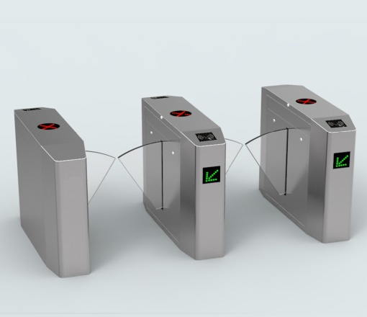
Data Structure -Introduction
Why?
Dictionary
Metro Gates

Slide 19

Data Structure -Introduction
Why?
Dictionary
Metro Gates
Map

Slide 20
Data Structure -Introduction
Why?
Each Data Structure allows data to be stored in specific manner
It allows efficient data search and retrieval
It allows to manage large amount of data such as large database.

Slide 21
Data Structure -Introduction
Where?
Folders in File system

Slide 22
Data Structure -Introduction
Where?
Folders in File system
Data Structure
Class work
Assignment
Project
1.c
2.c
3.c

Slide 23
Data Structure -Introduction
Where?
Folders in File system
Data Structure
Class work
Assignment
Project
1.c
2.c
3.c

Slide 24
Data Structure -Introduction
Where?
Folders in File system
Data Structure
Class work
Assignment
Project
1.c
2.c
3.c

Slide 25
Data Structure -Introduction
Where?
Folders in File system
Tree
Data Structure
Class work
Assignment
Project
1.c
2.c
3.c

Slide 26

Data Structure -Introduction
Where?
Image Viewer
Photo -1

Slide 27

Data Structure -Introduction
Where?
Image Viewer
Photo -1
Photo -2

Slide 28

Data Structure -Introduction
Where?
Image Viewer
Photo -1
Photo -2
Photo -3

Slide 29
Data Structure -Introduction
Where?
Image Viewer
Photo -1
Photo -2
Photo -3

Slide 30
Data Structure -Introduction
Where?
Image Viewer
Photo -1
Photo -2
Photo -3

Slide 31
Data Structure -Introduction
Where?
Image Viewer
Photo -1
Photo -2
Photo -3

Slide 32
Data Structure -Introduction
Where?
Image Viewer
Double Linked list
Photo -1
Photo -2
Photo -3

Slide 33
Data Structure -Introduction
Where?
Browser

Slide 34
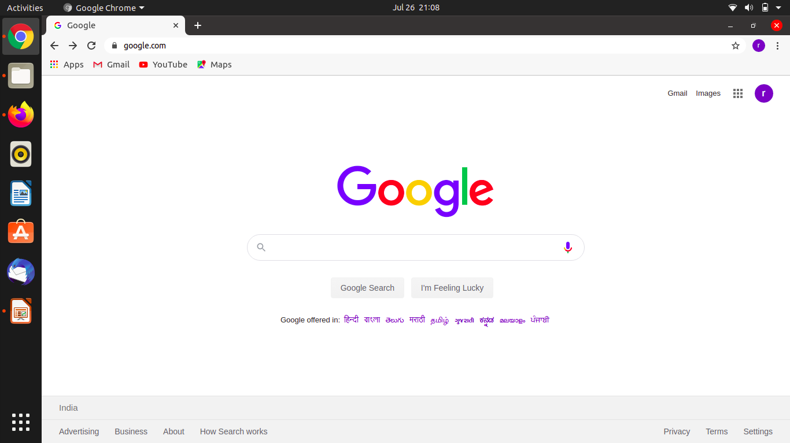
Data Structure -Introduction
Where?
Browser

Slide 35
Data Structure -Introduction
Where?
Browser
Stack

Slide 36
Data Structure -Introduction
Where?
Browser
www.google.com
Stack

Slide 37

Data Structure -Introduction
Where?
Browser
www.emertxe.com
www.google.com
Stack

Slide 38

Data Structure -Introduction
Where?
Browser
www.youtube.com/channel/U
www.emertxe.com
www.google.com
Stack

Slide 39
Data Structure -Introduction
Where?
Browser
www.youtube.com/channel/U
www.emertxe.com
www.google.com
Stack

Slide 40
Data Structure -Introduction
Where?
Browser
www.youtube.com/channel/U
www.emertxe.com
www.google.com
Stack

Slide 41
Data Structure -Introduction
Where?
Browser
www.emertxe.com
www.google.com
Stack

Slide 42
Data Structure -Introduction
Where?
Browser
LIFO
www.google.com
Stack

Slide 43
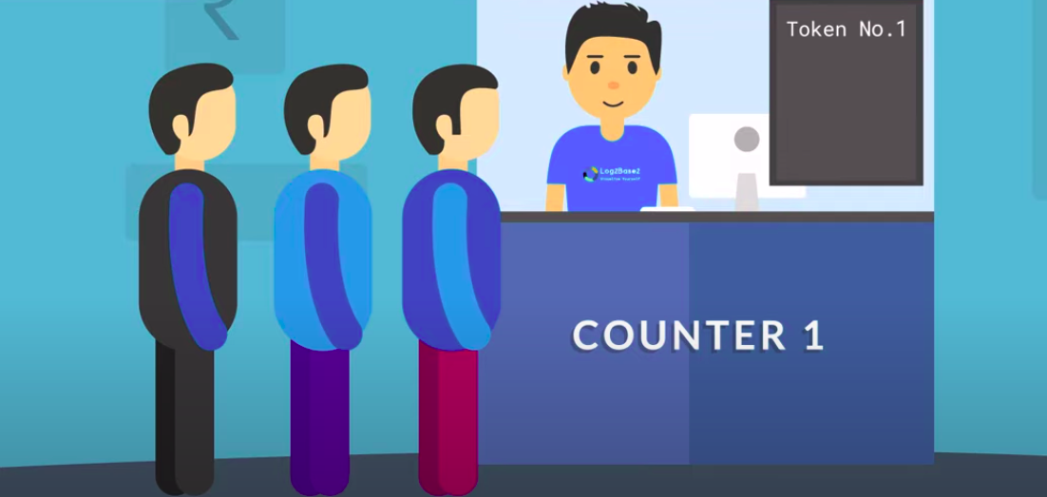
Data Structure -Introduction
Where?
Queue

Slide 44
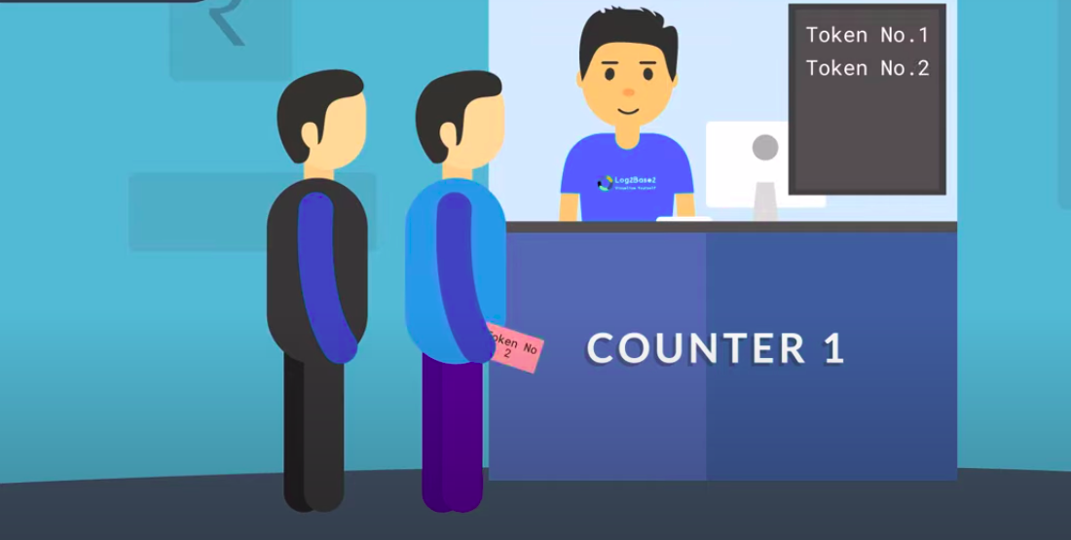
Data Structure -Introduction
Where?
Queue

Slide 45
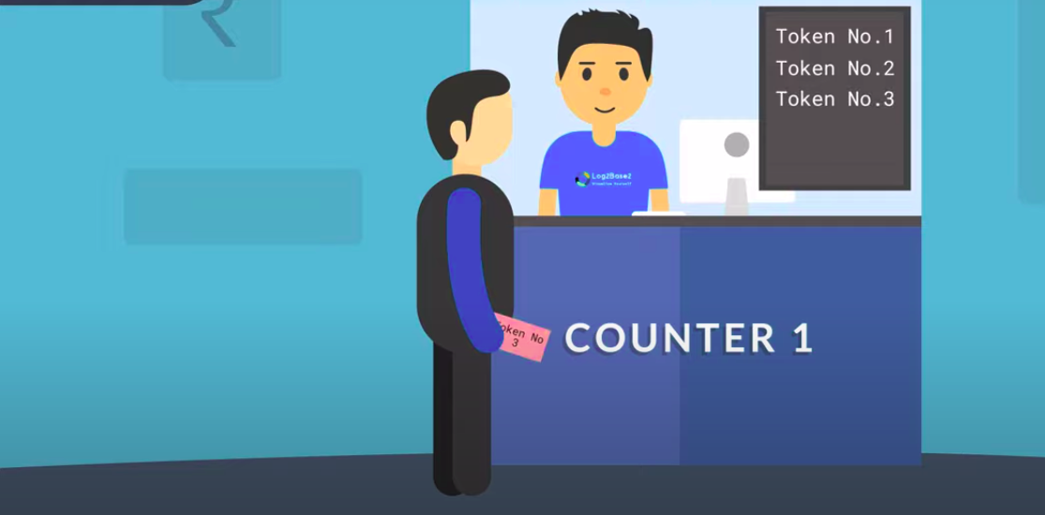
Data Structure -Introduction
Where?
Queue

Slide 46
Data Structure -Introduction
Where?
Queue
FIFO

Slide 47
Data Structure -Introduction
Where?
Applications
CPU Scheduling
Function
Expression Evaluation
Undo +Redo

Slide 48
Makefile

